Slide 1


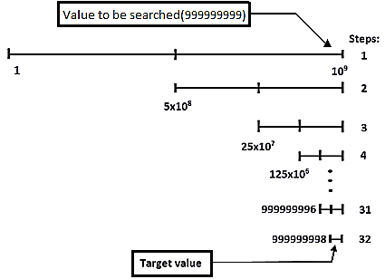
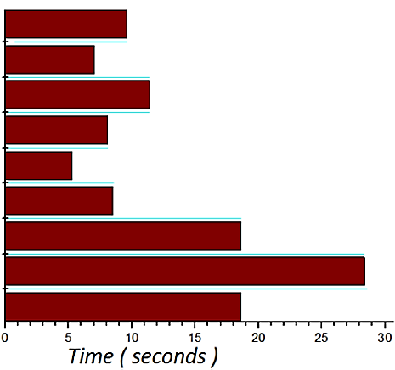


IARPIC-2018 (4) Advances in Monte Carlo methods in Radiation Transport
Sachin Shet, K.V.Subbaiah.
Manipal Centre for Natural Sciences, MAHE, Manipal-576104, Karnataka, India.
INTRODUCTION
Monte Carlo (MC) technique is widely employed for solving practical radiation transport problems. This technique is based on the simulation of a “history of a particle” which accounts for the absorption as well as energy transfer mechanisms. Such simulations are useful in predicting the radiation field strengths around the radiation sources thereby enabling control of exposures happening in the nuclear fuel cycle facilities. MC simulation requires copious quantity of random numbers in the range (0 to 1) and the cumulative probability density functions (CDF) which need to be deduced from Evaluated Nuclear Data File (ENDF). The main difficulty in the case of neutron transport with point cross sections is the number of data points are voluminous and vary widely from one nuclide to the other. For instance hydrogen has few hundred points whereas uranium contains several thousands. In the present work, the usage of computer memory in handling voluminous data is optimized by the use of dynamic allocation and de-allocation. MC codes known to consume a lot of CPU time, which can be reduced considerably by adopting unionized energy grid method and efficient search algorithm.
MATERIALS AND METHODS
Major components of Monte Carlo methods are:
1. Random number generator (RNG)
2. Sampling theory
3. Scoring
4. Error estimation
5. Variance reduction techniques
Monte Carlo technique known to take considerable amount of CPU time compared to the other methods. To reduce the CPU time, this method is programmed on machines with multiple processors. .The random number generator for these machines to be of the form:
$$ξ_{i+k }= g^{k}ξ_{i}+c \frac{g^{k}−1}{g−1} mod M$$
Where
$ξ_{i+k }$ is i+k ^{th} random number,
i and k are integers,
g is the multiplier,
c is the additive term.
4. Search algorithms:
At each interaction point it is required to compute the total and individual reaction cross-section of all nuclides present, by searching huge data table. For instance in a table of length 1 billion to search by usual method for a value located at the fag end, on a computer operating at 1 million operations per second, it requires 1000 seconds(16 minutes for a single operation). If binary search algorithm adopted, which requires only 32 µs for the same operation. Thus the use of Binary search algorithms reduces the CPU time drastically. The same is shown schematically in Fig.2.
RESULTS AND DISCUSSION
The following are the advances¹ attempted in the present work in reducing the CPU time and memory storage for handling data.
Comparison of search algorithms:
2. Dynamic allocation of memory
To store and access unstructured data which varies widely from one nuclide to another, it occupies a large amount of computer memory in conventional programming method. However, the use of “ALLOCATABLE” statement, allows the user to dynamically allocate the required memory space as well as temporary space. Further, the statement of “DEALLOCATE” enables one to remove and reuse the temporary memory again and again for different purposes.
Memory Usage:
1) Static Allocation
Dynamic Allocation
A. Sequential Search: Number of Steps : N
( total number of elements in search )
1. Random number generators-CPU time optimization
In the literature² a large number of RNGs are available which satisfies minimal statistical tests. For selecting a fast RNG which takes minimum CPU time, RNGs listed in table.1 are tested for the time required to generate 100 million random numbers, and the results are shown in figure.1
Table.1 Random Number Generating Functions with description
999,999,999
B. Binary Search: Number of Steps : log₂N
Description | Seeds | Period | Average
1. r4_random ( s1, s2, s3 ) | 3 | 6.9x10¹² | 0.4998
2. r4_uni ( s1, s2 ) | 2 | 2.3x10¹⁸ | 0.5000
3. r8_random ( s1, s2, s3 ) | 3 | 6.9x10¹² | 0.4998
4. r8_uni ( s1, s2 ) | 2 | 2.3x10¹⁸ | 0.5000
5. r4_uniform_01 ( s ) | 1 | NA | 0.4997
6. r8_uniform_01 ( s ) | 1 | NA | 0.4997
7. r8_uniform_02 ( s ) | 1 | NA | 0.4997
8. ranC( s ) | 1 | >2x10¹⁸ | 0.4999
9. ranE( s ) | 1 | >2x10¹⁸ | 0.5003
Unused
Figure.2 Binary search illustration
Used
Memory
CONCLUSION
The CPU time and the Computer memory are the two disadvantage factors for employing Monte Carlo methods for solving radiation transport problems. Due to progress made in the hardware and software, the above are no longer major problems. Use of dynamic allocation of memory and employment of efficient search algorithms make Monte Carlo methods more attractive than others.
Free
Used
Memory
3. Unionized energy grid method to reduce CPU time:
In sampling of nuclide and type of reaction taking place it is required to search the large data table of nuclides. This can be avoided by using the unionized energy grid. The CPU time can be improved by the use of unionized energy grid method and by following the improved search algorithms. Thus saving CPU time.
REFERENCES
Paul K Romano and Benoit Forget, (2013),”The OpenMC Monte Carlo Transport Code”, Ann.Nuc.Eneergy, Vol.51, P-274-281.
Press W.H. et al., (1992), “Numerical Recipes in Fortran, The art of scientific computing”. second Ed. P-266-320.
1. r4_random ( s1, s2, s3 ).
2. r4_uni ( s1, s2 ).
3. r8_random ( s1, s2, s3 ).
4. r8_uni ( s1, s2 ).
5. r4_uniform_01 ( s ).
6. r8_uniform_01 ( s ).
7. r8_uniform_02 ( s ).
8. ranC( s ).
9. ranE( s )
Figure.1 Random number generating functions with time for 100 million random numbers generation
Nuclide - 1
Nuclide - 2
Unionized
Grid
E=1
E-1
E=2
E=3
E=2
E=3
U
E=4
=
E=3
ACKNOWLEDGEMENT
Authors express sincere thanks to Dr. Kapil Deo Singh and Dr. S. Anand for the training and for the constant encouragement. And I am thankful for the guidance given by other supervisor as well as the panels especially in our project.
E=4
E=5
E=4
E=5
E=6
E=5
E=7
E=6
E=7

